Slide 1
ESSENTIALS OF GRAPH THEORY

Slide 2
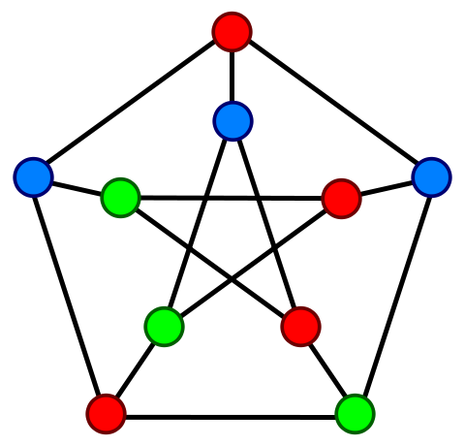
What is a Graph?
A graph has set of nodes and set of edges that connect these nodes.
A graph G = (V, E) consists of a non empty finite set V of nodes and a set E of edges containing ordered or unordered pairs of nodes.
V = (n1, n2, n3……..nm) and E = (e1, e2, e3………ek).

Slide 3
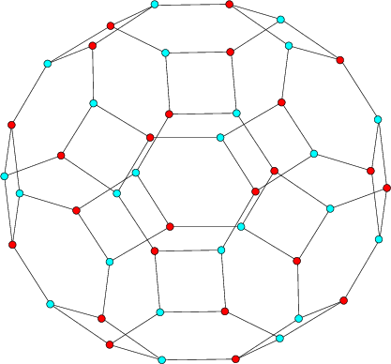
What is a Graph?
If an edge ei E is associated with an ordered pair <ni, nj> or an unordered pair (ni, nj), where ni, nj ε V, then the ei is said to connect the nodes ni and nj.
The edge ei that connects the node ni and nj is called incident on each of the nodes.

Slide 4
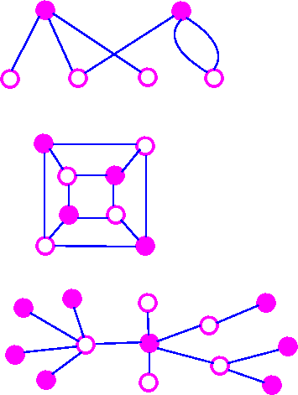
What is a Graph?
The pair of nodes that are connected by an edge are called adjacent nodes.
A node, which is not connected to any other node is called an isolated node.
A graph with only isolated nodes is known as null graph.

Slide 5
What is a Graph?
n₁
n₁
e₁
e₂
e₁
e₂
n₂
n₃
n₂
n₃
e₃
e₄
e₃
e₄
n₄
n₅
n₆
n₄
n₅
n₆
(a) Undirected graph with 6 nodes and 4 edges
(b) Directed graph with 6 nodes and 4 edges

Slide 6
What is a Graph?
The only difference is that edges are the ordered pairs of nodes represented by <n1, n2> rather than unordered pairs (n1, n2).
An edge of a graph having same node at its end points is called a loop.
e₁
n₁
n₁
e₂
e₃
e₁
e₃
e₂
n₂
n₃
n₂
n₃
e₄
e₅
e₄
e₆
e₅
n₄
n₅
n₄
n₅
(a) Graph with loop e₁
(b) Undirected graph with parallel edges e₁, e₂ and e₅, e₆

Slide 7
What is a Graph?
If certain pairs of nodes are connected by more than one edge in a directed or undirected graph, then these edges are known as parallel edges.
A graph that has neither loops nor parallel edges is called a simple graph.
A graph with one or more parallel edges is called a multigraph.

Slide 8
What is a Graph?
Degree of a node
Degree of a node in an undirected graph is the number of edges incident on it. However, a loop contributes twice to the degree of that node.
Degree of an isolated node is always 0.
In case of directed graphs, direction of edges play an important role and indegree and outdegree of a node is calculated.
Indegree of a node in a directed graph is the number of edges that are using that node as a terminal node. The indegree of a node n is represented by indeg(n).
Outdegree of a node in a directed graph is the number of edges that are using that node as a start node.

Slide 9
What is a Graph?
Degree of a node
deg(n) = indeg(n) + outdeg(n)
Few important characteristics of nodes are identified on the basis of indegree and outdegree and are given as:
  Source node: A node with indegree = 0
  Destination node: A node with outdegree = 0
  Sequential node: A node with indegree = 1 and outdegree = 1
  Predicate/decision node: A node with outdegree ≥ 2
  Junction node: indegree ≥ 2

Slide 10
What is a Graph?
Regular graph
3-regular graphs
2-regular graphs

Slide 11
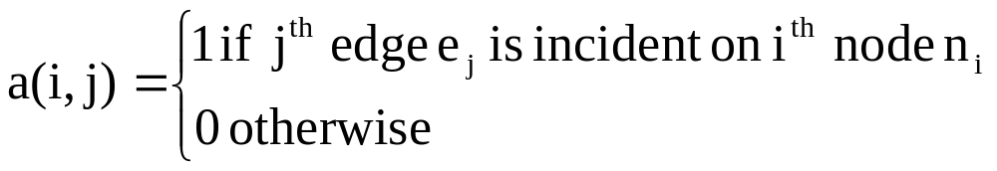
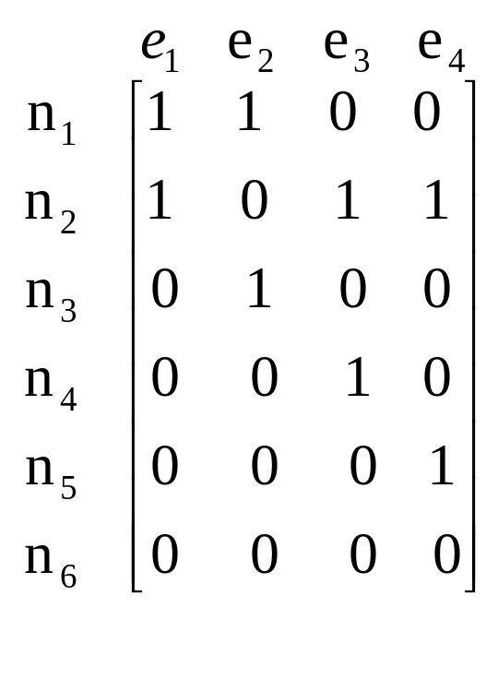
Matrix Representation of Graphs
Incidence matrix
n₁
e₁
e₂
n₂
n₃
e₃
e₄
n₄
n₅
n₆

Slide 12
Matrix Representation of Graphs
Incidence matrix
Sum of entries of any column of incidence matrix is always 2
If we add entries of a row, which is corresponding to a node, we get the degree of that node.
If all entries of a row are 0’s, then corresponding node is an isolated node.

Slide 13
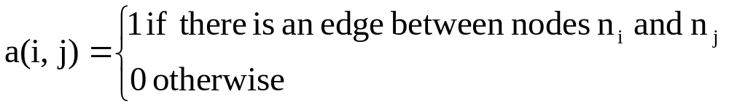
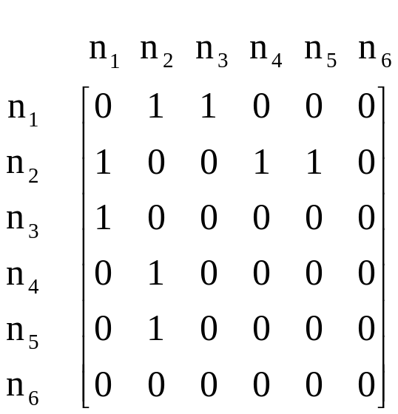
Matrix Representation of Graphs
Adjacency matrix
n₁
e₁
e₂
n₂
n₃
e₃
e₄
n₄
n₅
n₆

Slide 14
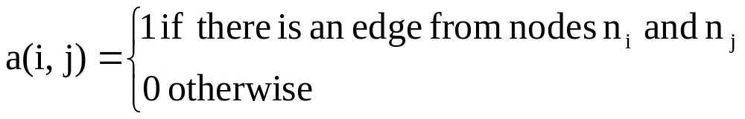
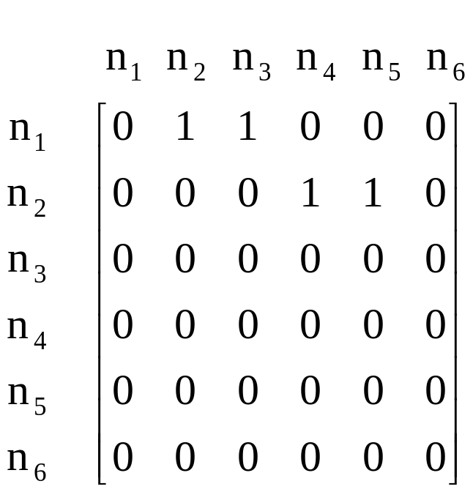
Matrix Representation of Graphs
Adjacency matrix
n₁
e₁
e₂
n₂
n₃
e₃
e₄
n₄
n₅
n₆

Slide 15

Paths and Independent Paths
A path in a graph is a sequence of adjacent nodes where nodes in sequence share a common edge or sequence of adjacent pair of edges where edges in sequence share a common node.

Slide 16
Paths and Independent Paths
Consider the graph shown in below and find its path.
n₁
e₁
e₂
n₂
n₃
e₃
e₄
n₄
n₅
n₆

Slide 17
Paths and Independent Paths
S.No. | Paths from initial node to final node | Sequence of nodes | Sequence of edges
1 | n₁ to n₄ | n_{1,} n_{2,} n₄ | e_{1,} e₃
2 | n₁ to n₅ | n_{1,} n_{2,} n₅ | e_{1,} e₄
3 | n₁ to n₂ | n_{1,} n₂ | e₁
4 | n₁ to n₃ | n_{1,} n₃ | e₂
5 | n₂ to n₄ | n_{2,} n₄ | e₃
6 | n₂ to n₅ | n_{2,} n₅ | e₄
7 | n₂ to n₁ | n_{2,} n₁ | e₁
8 | n₃ to n₁ | n_{3,} n₁ | e₂
9 | n₄ to n₂ | n_{4,} n₂ | e₃
10 | n₄ to n₁ | n_{4,} n_{2,} n₁ | e_{3,} e₁

Slide 18
Paths and Independent Paths
S.No. | Paths from initial node to final node | Sequence of nodes | Sequence of edges
11 | n₅ to n₂ | n_{5,} n₂ | e₄
12 | n₅ to n₁ | n_{5,} n_{2,} n₁ | e_{4,} e₁
13 | n₂ to n₃ | n_{2,} n_{1,} n₃ | e_{1,} e₂
14 | n₃ to n₂ | n_{3,} n_{1,} n₂ | e_{2,} e₁
15 | n₄ to n₃ | n_{4,} n_{2,} n_{1,} n₃ | e_{3,} e_{1,} e₂
16 | n₃ to n₄ | n_{3,} n_{1,} n_{2,} n₄ | e_{2,} e_{1,} e₃
17 | n₄ to n₅ | n_{4,} n_{2,} n₅ | e_{3,} e₄
18 | n₅ to n₄ | n_{5,} n_{2,} n₄ | e_{4,} e₃
19 | n₅ to n₃ | n_{5,} n_{2,} n_{1,} n₃ | e_{4,} e_{1,} e₂
20 | n₃ to n₅ | n_{3,} n_{1,} n_{2,} n₅ | e_{2,} e_{1,} e₄

Slide 19
Paths and Independent Paths
The direction of an edge provides more meaning to a path.
Paths of a directed graph seem to be more practical and useful. They are also called chains.
Consider the directed graph given below and find the paths in it.
n₁
e₁
e₂
n₂
n₃
e₃
e₄
n₄
n₅
n₆

Slide 20
Paths and Independent Paths
S.No. | Paths from initial node to final node | Sequence of nodes | Sequence of edges
1 | n₁ to n₄ | n_{1,} n_{2,} n₄ | e_{1,} e₃
2 | n₁ to n₅ | n_{1,} n_{2,} n₅ | e_{1,} e₄
3 | n₁ to n₂ | n_{1,} n₂ | e₁
4 | n₁ to n₃ | n_{1,} n₃ | e₂
5 | n₂ to n₄ | n_{2,} n₄ | e₃
6 | n₂ to n₅ | n_{2,} n₅ | e₄

Slide 21
Matrix Representation of Graphs
Cycles
When the initial and final nodes of a path are the same and if length ≠ 0, the path is called a cycle.
n₁
e₁
e₂
n₂
n₃
e₃
e₄
e₅
e₆
n₄
n₅
n₆

Slide 22
Matrix Representation of Graphs
Connectedness of a graph
An undirected graph is said to be connected if there is a path between every pair of nodes of the graph, otherwise it is said to be disconnected graph.
A disconnected graph is the union of two or more disjoint portions of the graph. These disjoint portions are called the connected components of the graph.
A directed graph is said to be strongly connected if there is a path from node ni to node nj; where node ni and nj are any pair of nodes of the graph

Slide 23
Matrix Representation of Graphs
Connectedness of a graph: Strongly connected graph
A directed graph is said to be strongly connected if there is a path from node ni to node nj; where node ni and nj are any pair of nodes of the graph.
n₁
n₂
n₃
n₄

Slide 24
Matrix Representation of Graphs
Connectedness of a graph: Weakly connected graph
A directed graph is said to be weakly connected, if there is a path between every two nodes when the directions of the edges are not considered.
n₁
n₂
n₃
n₄

Slide 25
Matrix Representation of Graphs
Consider the following undirected graph and find:
Degree of all nodes
Incidence matrix
Adjacency matrix
Paths
n₁
e₁
e₂
n₂
n₃
e₃
e₄
e₅
e₆
n₄
n₅
n₆
n₇

Slide 26
Generation of a Graph from Program
“A program graph is a directed graph in which nodes are either statements or fragments of a statement and edges represent flow of control.”

Slide 27
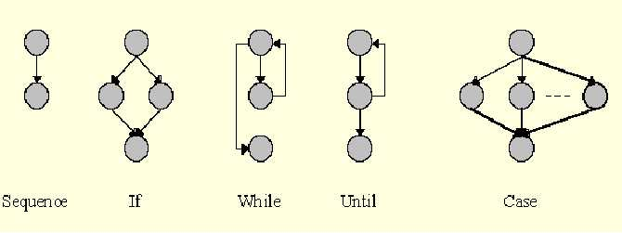
Generation of a Graph from Program

